Slide 1
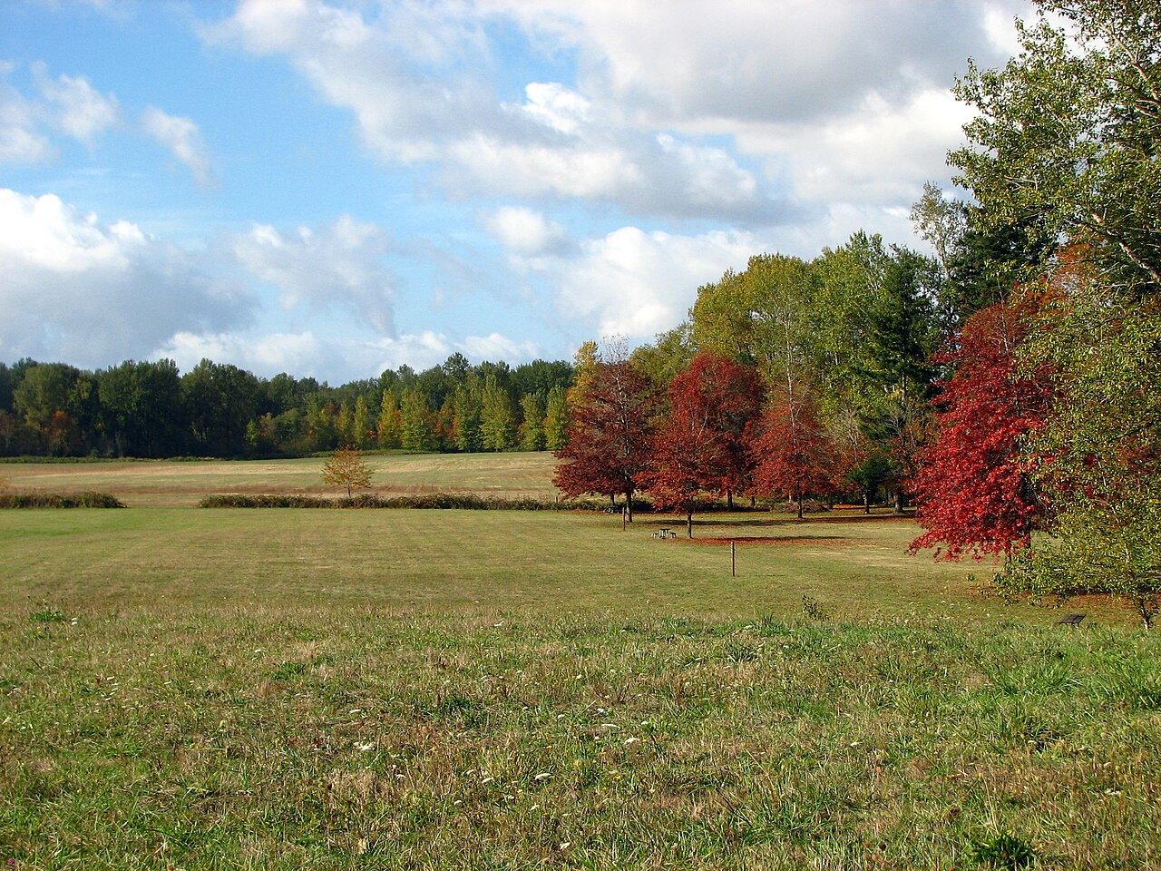
The Cornelius church of Christ
Welcomes You!

Slide 2
Order of Services
Sunday, October 29
Songs
s67
Opening Prayer Ryan Sollars
Song leader Joshua Jones
Scripture Lamar McDonald
Lord’s Table Barry Root
Roy Farris
Greg Durham
Michael Hetzer
Closing Anthony Ward

Slide 3
Children: Luke 18:15-17
How does one receive the kingdom like a child?
What attributes of children are being exalted?
What are some of the other Bible ideas that exalt children?

Slide 4
The Rich Young Ruler: Luke 18:18-30
Why do we identify him as a “rich, young ruler” when the text only calls him a ruler?
Is there any indication that this person lied about the commands he kept?
Per Mark 10:21, how did Jesus react to his response?
Are Christians commanded to give away all of their possessions to the poor?

Slide 5
The Rich Young Ruler: Luke 18:18-30
What does Jesus mean to say “easer for a camel to go through the eye of a needle”?
Why would the crowd think this means no one could be saved?
Why does Peter make the declaration he does here? What does Jesus’ reply mean?
If this story were about you, what would Jesus tell you to give away?

Slide 6
The Rich Young Ruler: Luke 18:18-30
What does Jesus mean to say “easer for a camel to go through the eye of a needle”?
Why would the crowd think this means no one could be saved?
Why does Peter make the declaration he does here? What does Jesus’ reply mean?
If this story were about you, what would Jesus tell you to give away?

Slide 7
The Cornelius church of Christ
Welcomes You!

Slide 8
Order of Services
Sunday, October 29
Songs
s67
Opening Prayer Ryan Sollars
Song leader Joshua Jones
Scripture Lamar McDonald
Lord’s Table Barry Root
Roy Farris
Greg Durham
Michael Hetzer
Closing Anthony Ward

Slide 9
Announcements
Men’s meeting today at 3PM
Bible Study Saturday 10AM at Forest Hills

Slide 10
CALL TO WORSHIP – SONG #55
The Lord is in His holy temple;
Let all the earth keep silence before Him.
Keep silence; keep silence;
Keep silence before Him.
Habakkuk 2:20

Slide 11
Order of Services
Sunday, October 29
Songs
s67
Opening Prayer Ryan Sollars
Song leader Joshua Jones
Scripture Lamar McDonald
Lord’s Table Barry Root
Roy Farris
Greg Durham
Michael Hetzer
Closing Anthony Ward

Slide 12
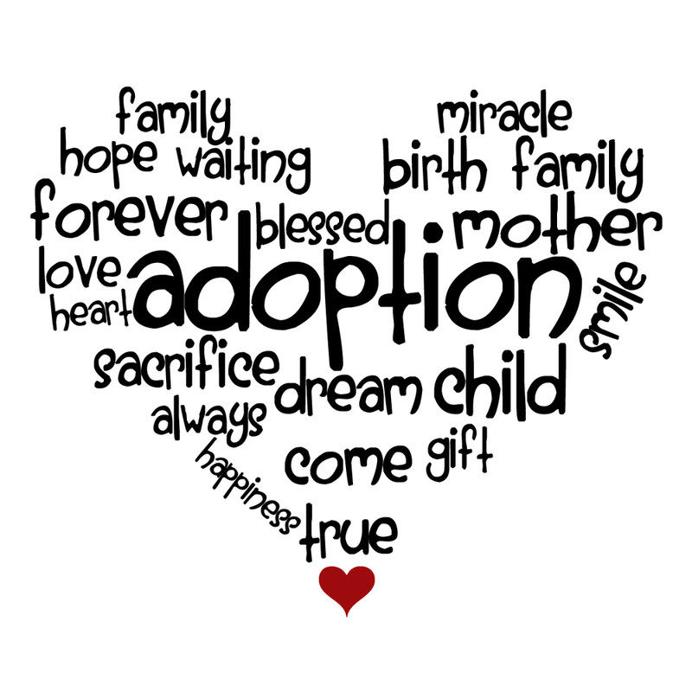
Notes:
November is national Adoption Month

Slide 13
Blessedness of Adoption
Pure and undefiled religion before God and the Father is this: to visit orphans and widows in their trouble, and to keep oneself unspotted from the world James 1:27

Slide 14
Adoptions of Scripture
Esther 1:5-7 – Esther
Exodus 2:1-11 - Moses
2 Samuel 9 – Mephibosheth
Notes:
Es 2:5 In Shushan the citadel there was a certain Jew whose name was Mordecai the son of Jair, the son of Shimei, the son of Kish, a Benjamite. 6 Kish had been carried away from Jerusalem with the captives who had been captured with Jeconiah king of Judah, whom Nebuchadnezzar the king of Babylon had carried away. 7 And Mordecai had brought up Hadassah, that is, Esther, his uncle's daughter, for she had neither father nor mother. The young woman was lovely and beautiful. When her father and mother died, Mordecai took her as his own daughter.

Slide 15
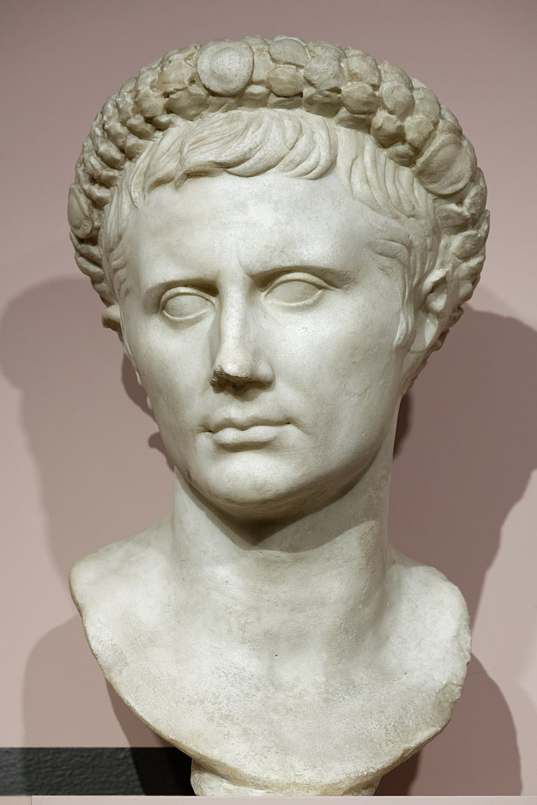
Adoptions in Rome
Child or adult
- Change of family name
- Total inclusion
- Total debt removal
Notes:
Augustus, adopted by Julius
https://en.wikipedia.org/wiki/Adoption_in_ancient_Rome
https://www.ogchurchofchrist.org/Sermons/spiritual-adoption/

Slide 16
Adoption of Grace
For you did not receive the spirit of bondage again to fear, but you received the Spirit of adoption by whom we cry out, "Abba, Father.“ Romans 8:15

Slide 17
Adoption of Grace
Ephesians 1:3-11
God’s desire to be our Father
1 John 3:1-2
Notes:
1Jo 3:1 ¶ Behold what manner of love the Father has bestowed on us, that we should be called children of God! Therefore the world does not know us, because it did not know Him. 2 Beloved, now we are children of God; and it has not yet been revealed what we shall be, but we know that when He is revealed, we shall be like Him, for we shall see Him as He is.

Slide 18
Adoption of Grace
Ephesians 1:3-11
God’s desire to be our Father
God’s willingness to pay the price
1 John 4:9-10
Notes:
1Jo 4:9 In this the love of God was manifested toward us, that God has sent His only begotten Son into the world, that we might live through Him. 10 In this is love, not that we loved God, but that He loved us and sent His Son to be the propitiation for our sins.

Slide 19
Adoption of Grace
Ephesians 1:3-11
God’s desire to be our Father
God’s willingness to pay the price
The inheritance of God
Colossians 1:12
Notes:
Col 1:12 ¶ giving thanks to the Father who has qualified us to be partakers of the inheritance of the saints in the light.

Slide 20
Adoption of Grace
Galatians 4:1-7
A servant or a son
Achieved through the Only Begotten Son
An heir of God through Christ
Notes:
Col 1:12 ¶ giving thanks to the Father who has qualified us to be partakers of the inheritance of the saints in the light.

Slide 21
Adoption of Grace
"In My Father's house are many mansions; if it were not so, I would have told you. I go to prepare a place for you.” John 14:2
Notes:
Col 1:12 ¶ giving thanks to the Father who has qualified us to be partakers of the inheritance of the saints in the light.

Slide 22
Contemplating the Adoption
1. Appreciate how valuable you are
- God wanted YOU as His child
- God wants YOU to live with Him

Slide 23
Contemplating the Adoption
1. Appreciate how valuable you are
2. Appreciate how valuable this is
- Your new name can be abandoned
- Your inheritance can be given up

Slide 25
His Adoption
Believe in Him – Rom. 10:10
Confess His Son – Rom. 10:9
Repent of your sins- Acts 2:38
Submit to baptism – Gal. 3:27
Remain faithful – Rev. 2:10
Notes:
When MIGHT the Lord return?

Slide 26
Song #302
Blest be the tie that binds
Our hearts in Christian love;
The fellowship of kindred minds
Is like to that above.

