Slide 1
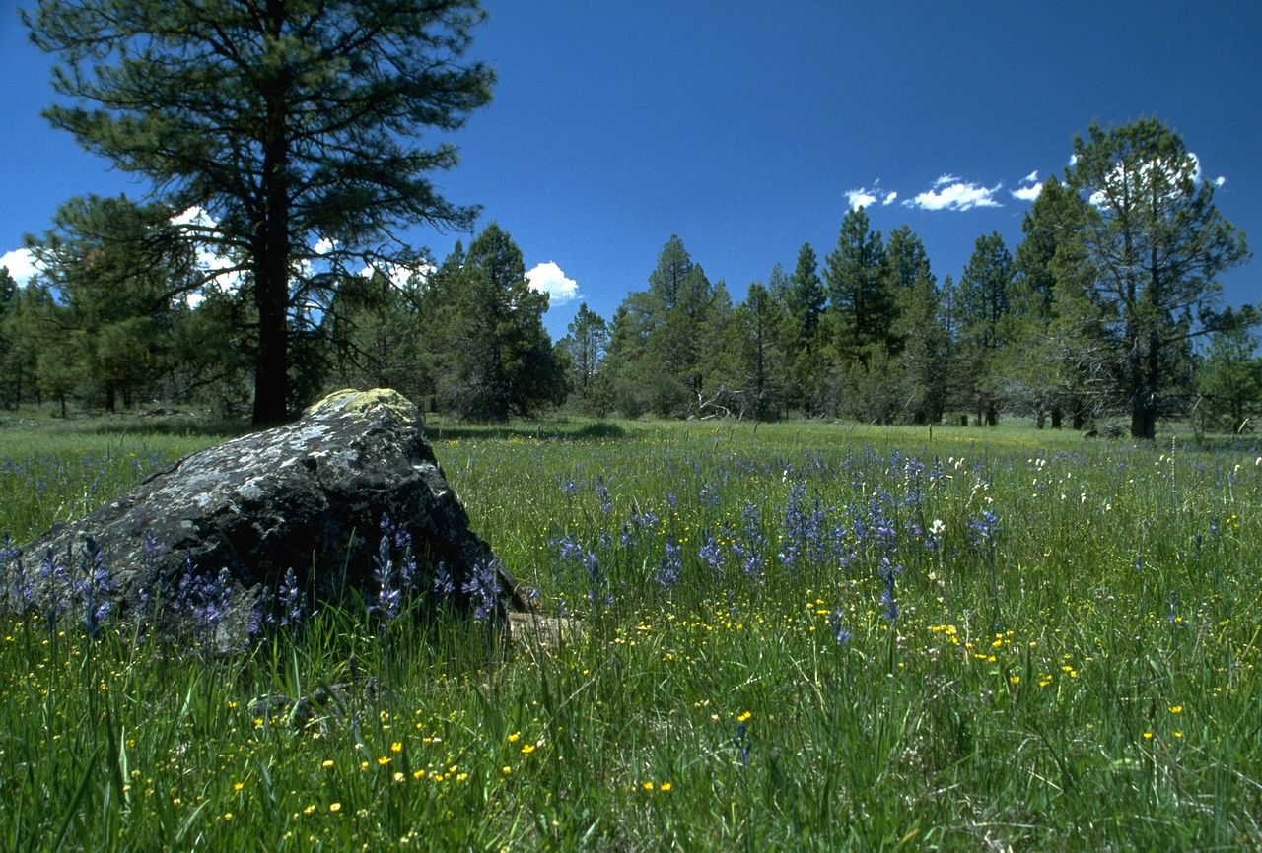
The Cornelius church of Christ
Welcomes You!

Slide 2
Order of Services Sunday, July 30
Songs
-
-
-
-
-
-
s107
Opening Prayer Roy Farris
Song leader Grant Haines
Scripture Ryan Sollars
Lord’s Table Michael Hetzer
Ryan Royland
Brian Haines
Gus Royland
Closing Greg Durham

Slide 3
Jesus at a Dinner: Luke 14:1-14
Explain the parable of the ox in the ditch
Explain the parable of feast seating
What does it mean that whoever exalts themselves will be humbled? Exalted?

Slide 4
Parable of the Feast: Luke 14:15-24
Who is the Host?
Who were the first guests?
What do we think of the reasons given not to attend the feast?
What is the significance of the people that were subsequently invited?

Slide 5
Order of Services Sunday, July 30
Songs
-
-
-
-
-
-
s107
Opening Prayer Roy Farris
Song leader Grant Haines
Scripture Ryan Sollars
Lord’s Table Michael Hetzer
Ryan Royland
Brian Haines
Gus Royland
Closing Greg Durham

Slide 6
CALL TO WORSHIP – SONG #55
The Lord is in His holy temple;
Let all the earth keep silence before Him.
Keep silence; keep silence;
Keep silence before Him.
Habakkuk 2:20

Slide 7
Order of Services Sunday, July 30
Songs
-
-
-
-
-
-
s107
Opening Prayer Roy Farris
Song leader Grant Haines
Scripture Ryan Sollars
Lord’s Table Michael Hetzer
Ryan Royland
Brian Haines
Gus Royland
Closing Greg Durham

Slide 8
Avoiding Division
Notes:
How many of us have experienced a church split?

Slide 9
Church Splits
1. The preacher
2. The elders
3. Member strife
4. Matters of discipline
5. Doctrinal difference
Notes:
Ac 2:42 ¶ They were continually devoting themselves to the apostles' teaching and to fellowship, to the breaking of bread and to prayer.

Slide 10
Church Splits
Now I plead with you, brethren, by the name of our Lord Jesus Christ, that you all speak the same thing, and that there be no divisions among you, but that you be perfectly joined together in the same mind and in the same judgment. 1 Corinthians 1:10
Notes:
Ac 2:42 ¶ They were continually devoting themselves to the apostles' teaching and to fellowship, to the breaking of bread and to prayer.

Slide 11
Church Splits
If any man destroys the temple of God, God will destroy him, for the temple of God is holy, and that is what you are. 1 Corinthians 3:17
Notes:
Ac 2:42 ¶ They were continually devoting themselves to the apostles' teaching and to fellowship, to the breaking of bread and to prayer.

Slide 12
How Can We Avoid This?
1. Talk to each other
2. Be engaged with everyone
3. Be spiritually minded
Notes:
The perfect time to talk about the dangers of division is when we are not facing them

Slide 13
Talk to Each Other
Positive communication
Hebrews 10:24-25
Colossians 4:6
When we have a problem
Matthew 18:15-17
Matthew 5:23-24
Gossip kills a church
Notes:
Heb 10:24 and let us consider how to stimulate one another to love and good deeds, 25 not forsaking our own assembling together, as is the habit of some, but encouraging one another; and all the more as you see the day drawing near.
Col 4:6 Let your speech always be with grace, seasoned with salt, that you may know how you ought to answer each one.
Mt 5:23 "Therefore if you are presenting your offering at the altar, and there remember that your brother has something against you, 24 leave your offering there before the altar and go; first be reconciled to your brother, and then come and present your offering.

Slide 14
Accept One Another
Total association
Acts 2:44
Romans 12:16
Avoiding cliques
Galatians 2:12
Politics, economics, family
Cliques kill a church
Notes:
Ac 2:44 And all those who had believed were together and had all things in common;
Ro 12:16 Be of the same mind toward one another; do not be haughty in mind, but associate with the lowly. Do not be wise in your own estimation.
Ga 2:12 For prior to the coming of certain men from James, he used to eat with the Gentiles; but when they came, he began to withdraw and hold himself aloof, fearing the party of the circumcision.

Slide 15
Spiritually Minded
Opinions, personality or doctrine?
James 3:17
Romans 14:1
Know opinion from doctrine
1 Timothy 1:3-4
Immaturity kills a church
Notes:
Jas 3:17 But the wisdom that is from above is first pure, then peaceable, gentle, willing to yield, full of mercy and good fruits, without partiality and without hypocrisy.
Ro 14:1 ¶ Now accept the one who is weak in faith, but not for the purpose of passing judgment on his opinions.
1Ti 1:3 As I urged you upon my departure for Macedonia, remain on at Ephesus so that you may instruct certain men not to teach strange doctrines, 4 nor to pay attention to myths and endless genealogies, which give rise to mere speculation rather than furthering the administration of God which is by faith.

Slide 16
Avoiding Division
Mindset among all
I will not gossip
I will associate with all brethren
I will work to understand opinions
I will work to grow my love
Notes:
Heb 10:23 Let us hold fast the confession of our hope without wavering, for He who promised is faithful. 24 And let us consider one another in order to stir up love and good works, 25 not forsaking the assembling of ourselves together, as is the manner of some, but exhorting one another, and so much the more as you see the Day approaching.

Slide 18
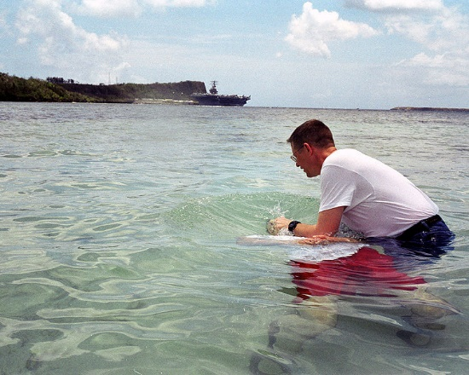
"Repent, and each of you be baptized in the name of Jesus Christ for the forgiveness of your sins; and you will receive the gift of the Holy Spirit” Acts 2:38b
Notes:
Heb 3:13 but exhort one another daily, while it is called "Today," lest any of you be hardened through the deceitfulness of sin.

Slide 19
Song #s107
1 Peter 5:6
Humble yourself in the sight of the Lord
(Women echo) Humble yourself in the sight of the Lord
(Women echo)
And He…. will lift…. you up
And He…. will lift…. you up

