Slide 1
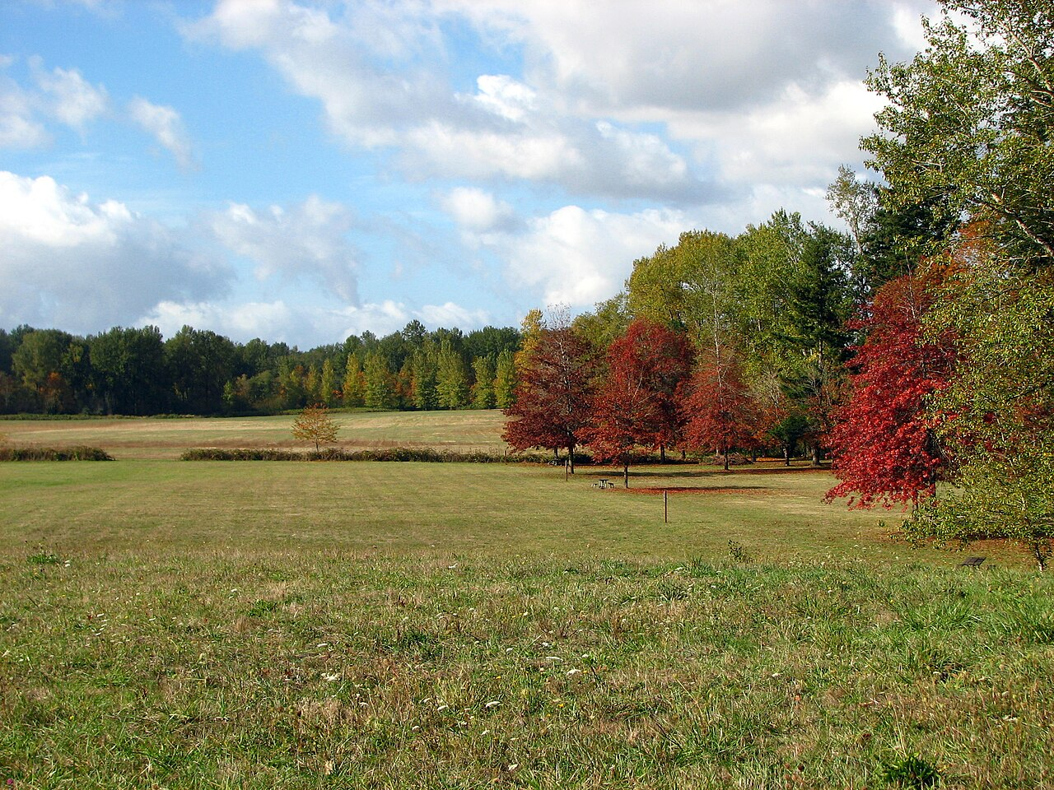
The Cornelius church of Christ
Welcomes You!

Slide 2
Order of Services Sunday, October 29
Songs
s67
Opening Prayer Ryan Sollars
Song leader Joshua Jones
Scripture Lamar McDonald
Lord’s Table Barry Root
Roy Farris
Greg Durham
Michael Hetzer
Closing Anthony Ward

Slide 3
Parable of Self-Righteous: Luke 18:9-14
Was the Pharisee sinning in declaring his good works? Were his works sinful?
What does it mean to be justified?
Why was the tax collector justified?
If you were retelling this parable today about two Christians, how would it go?
Notes:
Le 10:1 ¶ Then Nadab and Abihu, the sons of Aaron, each took his censer and put fire in it, put incense on it, and offered profane fire before the LORD, which He had not commanded them. 2 So fire went out from the LORD and devoured them, and they died before the LORD.

Slide 4
Children: Luke 18:15-17
How does one receive the kingdom like a child?
What attributes of children are being exalted?
What are some of the other Bible ideas that exalt children?

Slide 5
The Rich Young Ruler: Luke 18:18-30
Why do we identify him as a “rich, young ruler” when the text only calls him a ruler?
Is there any indication that this person lied about the commands he kept?
Per Mark 10:21, how did Jesus react to his response?
Are Christians commanded to give away all of their possessions to the poor?

Slide 6
The Rich Young Ruler: Luke 18:18-30
What does Jesus mean to say “easer for a camel to go through the eye of a needle”?
Why would the crowd think this means no one could be saved?
Why does Peter make the declaration he does here? What does Jesus’ reply mean?
If this story were about you, what would Jesus tell you to give away?

Slide 7
The Cornelius church of Christ
Welcomes You!

Slide 8
Order of Services Sunday, October 29
Songs
s67
Opening Prayer Ryan Sollars
Song leader Joshua Jones
Scripture Lamar McDonald
Lord’s Table Barry Root
Roy Farris
Greg Durham
Michael Hetzer
Closing Anthony Ward

Slide 9
Announcements
Men’s meeting today at 3PM
Bible Study Saturday 10AM at Forest Hills

Slide 10
CALL TO WORSHIP – SONG #55
The Lord is in His holy temple;
Let all the earth keep silence before Him.
Keep silence; keep silence;
Keep silence before Him.
Habakkuk 2:20

Slide 11
Order of Services Sunday, October 29
Songs
s67
Opening Prayer Ryan Sollars
Song leader Joshua Jones
Scripture Lamar McDonald
Lord’s Table Barry Root
Roy Farris
Greg Durham
Michael Hetzer
Closing Anthony Ward

Slide 12
Holiness
But as He who called you is holy, you also be holy in all your conduct, because it is written, "Be holy, for I am holy.“ 1 Peter 1:15-16

Slide 13
Holiness
What does it mean to be holy?
What does holiness do for us?
How do we remain holy?

Slide 14
What Does It Mean To Be Holy
For I am the LORD your God. You shall therefore consecrate yourselves, and you shall be holy; for I am holy. Neither shall you defile yourselves with any creeping thing that creeps on the earth. Leviticus 11:44

Slide 15
What Does It Mean To Be Holy
For I am the LORD your God. You shall therefore consecrate yourselves, and you shall be holy; for I am holy. Neither shall you defile yourselves with any creeping thing that creeps on the earth. Leviticus 11:44

Slide 16
What Does It Mean To Be Holy
For I am the LORD your God. You shall therefore consecrate yourselves, and you shall be holy; for I am holy. Neither shall you defile yourselves with any creeping thing that creeps on the earth. Leviticus 11:44

Slide 17
What Does It Mean To Be Holy
Leviticus 10 – Nadab and Abihu
Holy: “Approach with Caution”
Holiness is like electricity

Slide 18
What Does It Mean To Be Holy
The great dilemma:
Holiness requires approachability
Prayer requires approachability
Salvation requires approachability
Sacrifice requires approachability

Slide 19
What Does It Mean To Be Holy
The great dilemma:
Holiness requires approachability
Holiness is unapproachable if defiled
We are unclean / defiled by sin
How can we hope to be holy?

Slide 20
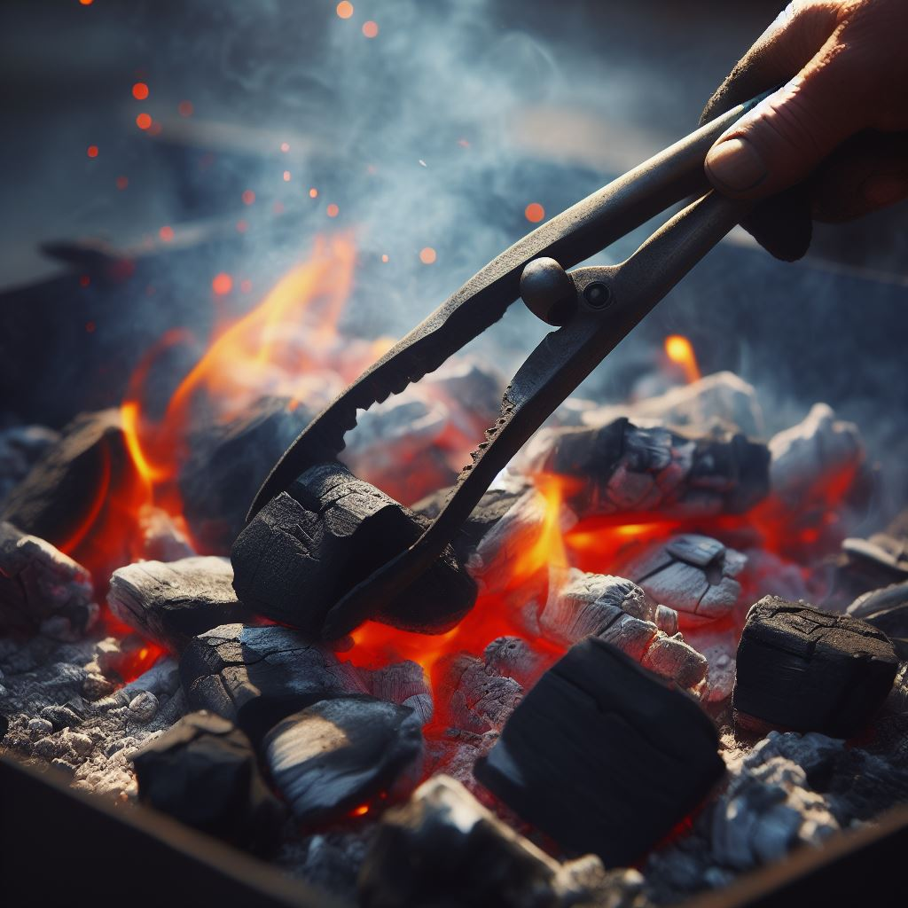
Isaiah’s Lesson
Isaiah 6
The unclean lips
A Live Coal that removed impurity

Slide 21
Isaiah’s Lesson
Such were some of you; but you were washed, but you were sanctified, but you were justified in the name of the Lord Jesus Christ and in the Spirit of our God 1 Corinthians 6:11

Slide 22
How Do We Remain Holy
We are made Holy by Jesus Christ
Baptism into Christ
Maintaining our Holy Robes

Slide 23
How Do We Remain Holy
"You have a few names even in Sardis who have not defiled their garments; and they shall walk with Me in white, for they are worthy.” Revelation 3:4

Slide 24
How Do We Remain Holy
"You have a few names even in Sardis who have not defiled their garments; and they shall walk with Me in white, for they are worthy.” Revelation 3:4
Notes:
Le 10:9 "Do not drink wine or intoxicating drink, you, nor your sons with you, when you go into the tabernacle of meeting, lest you die. It shall be a statute forever throughout your generations, 10 "that you may distinguish between holy and unholy, and between unclean and clean,

Slide 25
How Do We Remain Holy
Do you not know that you are the temple of God and that the Spirit of God dwells in you? If anyone defiles the temple of God, God will destroy him. For the temple of God is holy, which temple you are. 1 Corinthians 3:16-17
Notes:
Le 10:9 "Do not drink wine or intoxicating drink, you, nor your sons with you, when you go into the tabernacle of meeting, lest you die. It shall be a statute forever throughout your generations, 10 "that you may distinguish between holy and unholy, and between unclean and clean,

Slide 26
How Do We Remain Holy
How do we defile the temple?
Sexual Immorality - 1 Cor. 6:18-19
Evil speech – James 3:6
Bitter heart – Heb. 12:15
False doctrines – Titus 1:14-15
Notes:
Jas 3:6 And the tongue is a fire, a world of iniquity. The tongue is so set among our members that it defiles the whole body, and sets on fire the course of nature; and it is set on fire by hell.
Heb 12:15 looking carefully lest anyone fall short of the grace of God; lest any root of bitterness springing up cause trouble, and by this many become defiled;
Tit 1:14 not giving heed to Jewish fables and commandments of men who turn from the truth. 15 To the pure all things are pure, but to those who are defiled and unbelieving nothing is pure; but even their mind and conscience are defiled.

Slide 27
How Do We Remain Holy
For we have spent enough of our past lifetime in doing the will of the Gentiles--when we walked in lewdness, lusts, drunkenness, revelries, drinking parties, and abominable idolatries. In regard to these, they think it strange that you do not run with them in the same flood of dissipation, speaking evil of you. 1 Peter 4:3-4
Notes:
Le 10:9 "Do not drink wine or intoxicating drink, you, nor your sons with you, when you go into the tabernacle of meeting, lest you die. It shall be a statute forever throughout your generations, 10 "that you may distinguish between holy and unholy, and between unclean and clean,

Slide 28
How Do We Remain Holy
What happens when we are defiled?
John 9:31 – our prayers are not heard
Proverbs 15:8 – our sacrifices are in vain
Matthew 7:23 – entrance is denied

Slide 29
How Do We Restore Holilness
Can defilement be repaired?
If we confess our sins, He is faithful and righteous to forgive us our sins and to cleanse us from all unrighteousness 1 John 1:9

Slide 30
Be Holy
If you are in Christ, you are made holy
- Your prayers are before God
- Your sacrifices are received
- Your garment is cleansed
- Your hope is certain
Maintain that holiness!

Slide 32
Putting On Holiness….
Begins with Faith – Rom. 10:10
Requires a confession – Rom. 10:9
Demands Repentance - Acts 2:38
Culminates with Baptism – Gal. 3:27
Maintained in Faithfulness – Rev. 2:10
Notes:
When MIGHT the Lord return?

Slide 33
Song #s67
I love you Lord, and I lift my voice
To worship you, o my soul, rejoice!
Take joy, my King, in what you hear;
May it be a sweet, sweet sound in your ear

